Slide 1
Robotics Kinematics
BRAC University

Slide 2
Forward Kinematics
The process of determining the position and orientation of a robot's end effector given the joint parameters (angles for revolute joints, displacements for prismatic joints)
Joint angles
x, y, z
Importance:
Fundamental in robotics to control and predict the movement of robotic arms
Essential for tasks like positioning, navigation, and manipulation in automated systems.

Slide 3
Forward Kinematics
z2
(2,3)
z1
x2
Link
J1
x1
J2
The point (2, 3) is referenced in the coordinate frame of the second joint.
Our goal is to find the end effector position relative to the base frame.

Slide 4
Forward Kinematics
y2
y3
The point (x, y) is referenced in the frame of the (iii) joint.
Target: find the (x, y) relative to the (i) joint.
x2
x3
(x, y)
Note: Reference transformations are only possible between adjacent coordinate frames. Therefore, this is a sequential process
y1
(iii)
(i)
(ii)
x1
(x3, y3) (x2, y2) (x1, y1)
For every joint, we need to do one transformation.
Reference Transformation is done using Homogeneous Transformation Matrix.

Slide 5
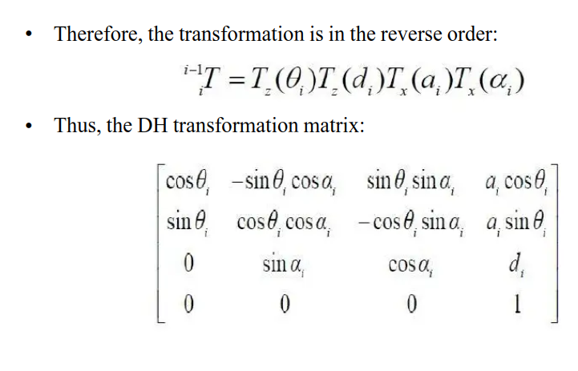
DH Transformation Matrix for a single joint

Slide 6
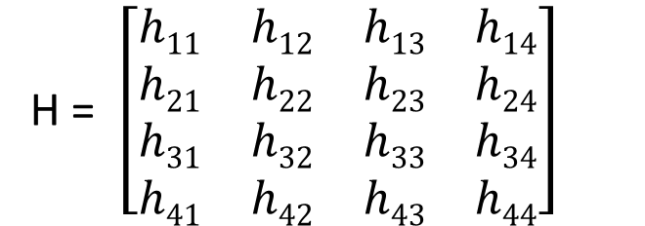
Homogeneous Matrix
A homogeneous matrix is a mathematical tool used to represent points in projective space, which allows us to perform geometric transformations (like translation, rotation, and scaling) in a unified way
Structure:
Typically a 4x4 matrix used to perform transformations in 3D space

Slide 7
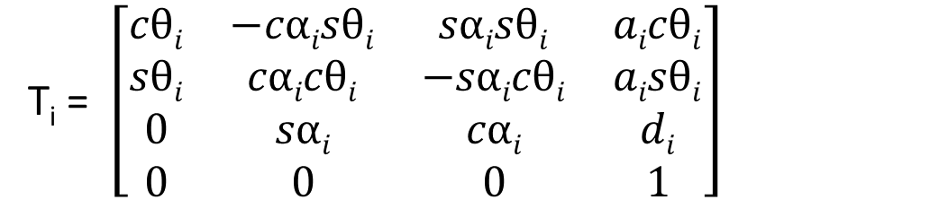
Homogeneous Transformation Matrix
A 4x4 matrix used in robotics and computer graphics to represent both rotation and translation in 3D space.
It allows us to combine these complex transformations into a single matrix multiplication, simplifying the calculation of a robot's end effector position and orientation in space.
Structure:
c -> cos
s -> sin

Slide 8
Homogeneous Transformation Matrix
A 4x4 matrix used in robotics and computer graphics to represent both rotation and translation in 3D space.
It allows us to combine these complex transformations into a single matrix multiplication, simplifying the calculation of a robot's end effector position and orientation in space.
Rotation Matrix
Translation Vector
Structure:
c -> cos
s -> sin
Scaling Factor
https://harry7557558.github.io/tools/matrixv.html

Slide 9
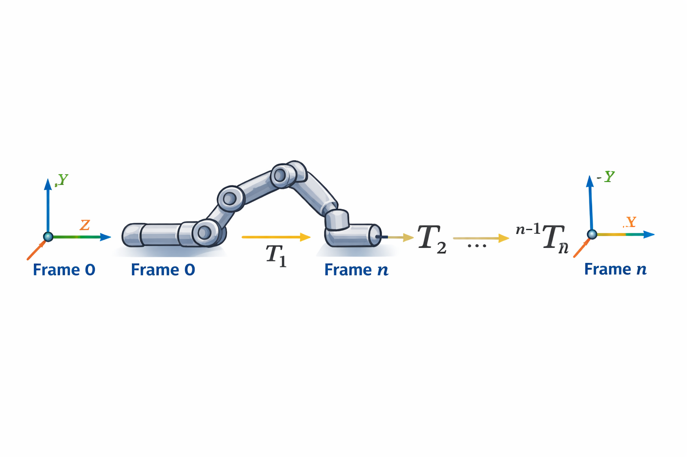
Manipulator Transformation Matrix
The position and orientation of end effector frame relative to the based frame can be found by consisting n consecutive link transformation matrices relating frames fixed to adjacent links.

Slide 10
Recall the Definition of the Four Parameters
Link Length (a_{i}): Distance between z_{i-1} and z_{i} along x_{i}
Link Twist (ɑ_{i}): Angle between z_{i-1} and z_{i} about x_{i}
Joint Offset (d_{i}): Distance between x_{i-1} and x_{i} along z_{i-1}
Joint Angle (Ө_{i}): Angle between x_{i-1} and x_{i} about z_{i-1}
Note: Don’t try to imagine the Y-axis
https://www.youtube.com/watch?v=rA9tm0gTln8

Slide 11
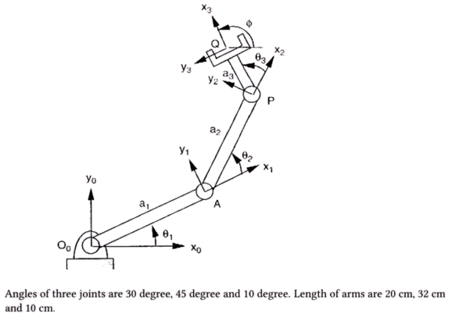
Exercise 1

Slide 12
Step 1: Form the DH parameter table
DH parameter Table
Joint | α | a | d | θ
1 | 0° | 20 | 0 | 30°
2 | 0° | 32 | 0 | 45°
3 | 0° | 10 | 0 | 10°

Slide 13
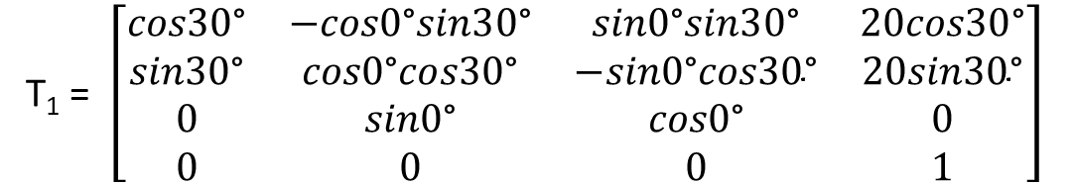

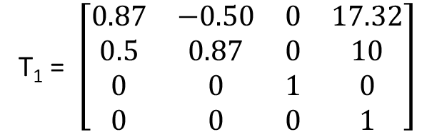
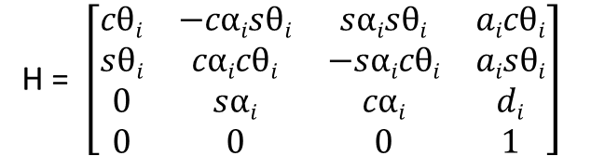
Step 2: For every Joint, find the transformation matrix
Joint 1
DH parameter Table
Joint | α | a | d | θ
1 | 0° | 20 | 0 | 30°
2 | 0° | 32 | 0 | 45°
3 | 0° | 10 | 0 | 10°

Slide 14
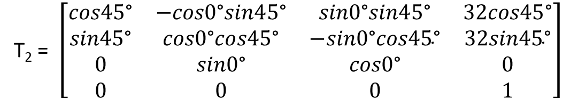

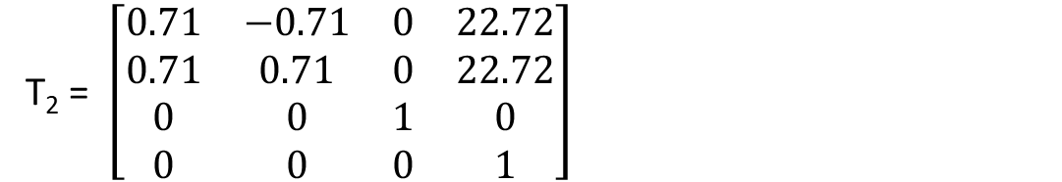
Step 2: For every Joint, find the transformation matrix
Joint 2
DH parameter Table
Joint | α | a | d | θ
1 | 0° | 20 | 0 | 30°
2 | 0° | 32 | 0 | 45°
3 | 0° | 10 | 0 | 10°

Slide 15
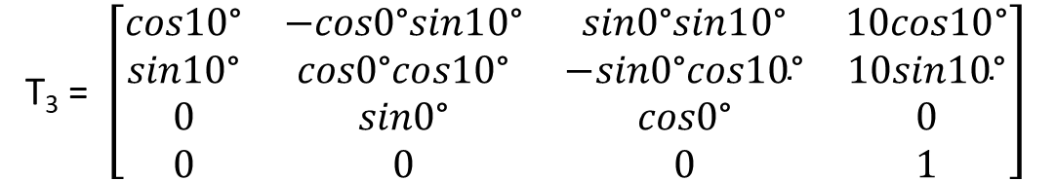

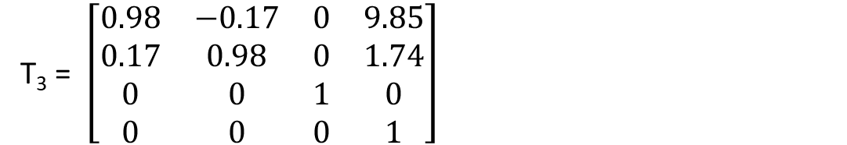
Step 2: For every Joint, find the transformation matrix
Joint 3
DH parameter Table
Joint | α | a | d | θ
1 | 0° | 20 | 0 | 30°
2 | 0° | 32 | 0 | 45°
3 | 0° | 10 | 0 | 10°

Slide 16
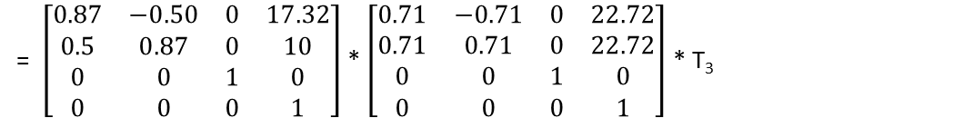
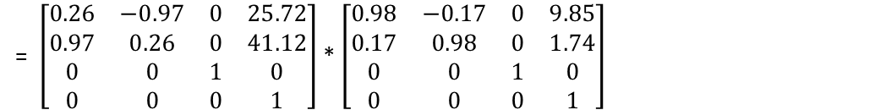
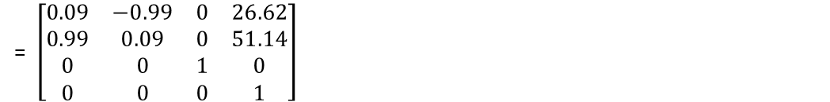
Step 3: Calculate the Overall Transformation Matrix
Overall transformation matrix,
DH parameter Table
T = T₁ * T₂ * T₃
Joint | α | a | d | θ
1 | 0° | 20 | 0 | 30°
2 | 0° | 32 | 0 | 45°
3 | 0° | 10 | 0 | 10°

Slide 17
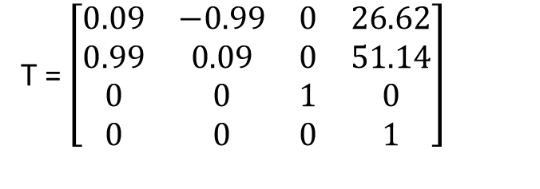
Step 4: Figure out the final position of the End-Effector
x
y
z
Overall transformation matrix,
So from the overall transformation matrix, x = 26.62, y = 51.14, z = 0
This is the final position of the end-effector that is relative to the base joint in the forward kinematic problem

Slide 18
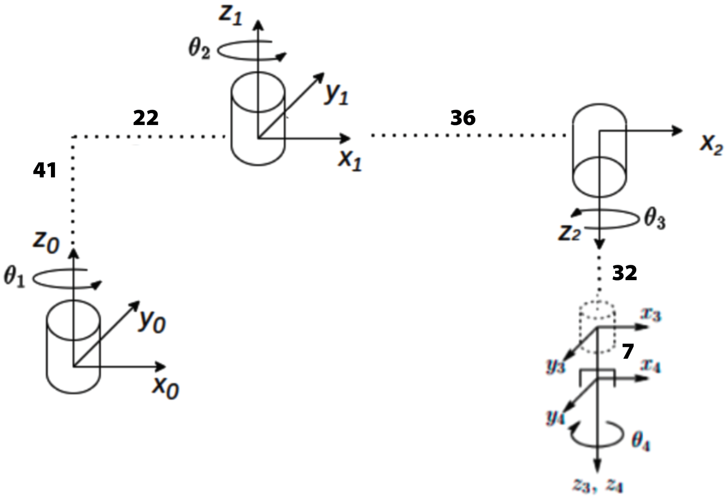
Exercise 2
What will be the final coordinate of the end effector if the joints rotate at 45, 27, 50 and 36 degrees respectively from joint 1 to joint 4.
i | Ө_{i} | a_{i} | d_{i} | α_{i}
1
2
3
4

Slide 19
Exercise 2
i | Ө_{i} | a_{i} | d_{i} | α_{i}
1 | 45 | 22 | 41 | 0
2 | 27 | 36 | 0 | 180º
3 | -50 | 0 | 32 | 0
4 | 36 | 0 | 7 | 0

Slide 20
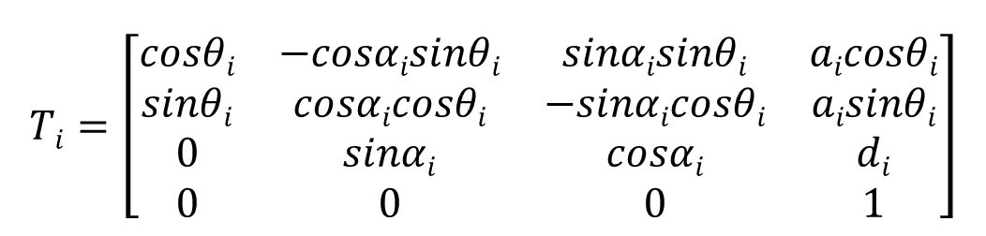
Exercise 1 (Cont.)
i | Ө_{i} | a_{i} | d_{i} | α_{i}
1 | 45 | 22 | 41 | 0
2 | 27 | 36 | 0 | 180º
3 | -50 | 0 | 32 | 0
4 | 36 | 0 | 7 | 0

Slide 21
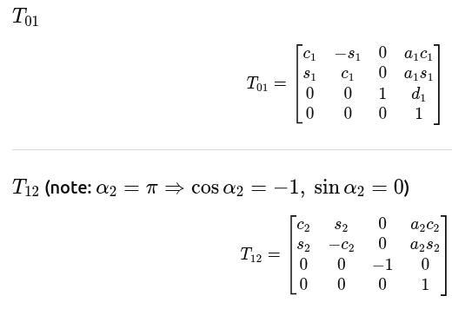
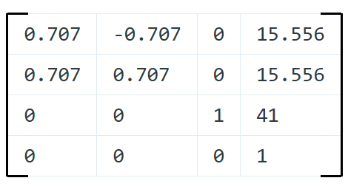
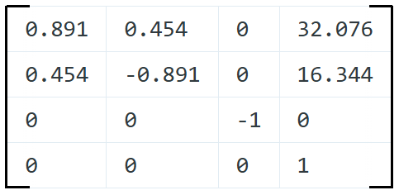
Exercise 1 (Cont.)
i | Ө_{i} | a_{i} | d_{i} | α_{i}
1 | 45 | 22 | 41 | 0
2 | 27 | 36 | 0 | 180º
3 | -50 | 0 | 32 | 0
4 | 36 | 0 | 7 | 0

Slide 22
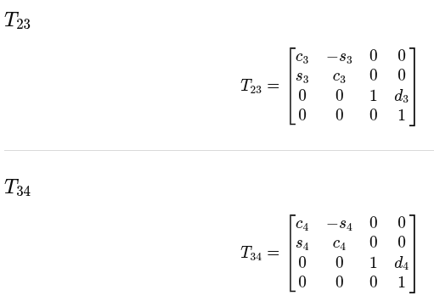
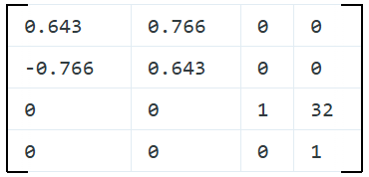
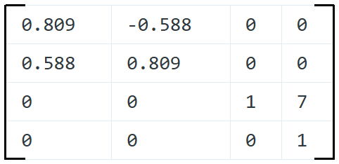
Exercise 1 (Cont.)
i | Ө_{i} | a_{i} | d_{i} | α_{i}
1 | 45 | 22 | 41 | 0
2 | 27 | 36 | 0 | 180º
3 | -50 | 0 | 32 | 0
4 | 36 | 0 | 7 | 0

Slide 23

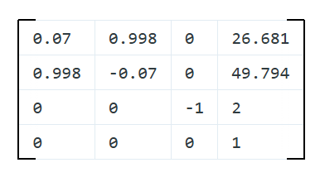
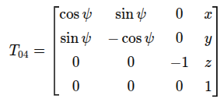
Exercise 1 (Cont.)

Slide 24
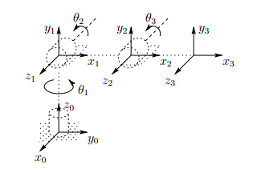
Exercise 3
i | Ө_{i} | a_{i} | d_{i} | α_{i}
1 | +Ө₁ | 0 | h | 90º
2 | +Ө₂ | L₂ | 0 | 0
3 | +Ө₃ | L₃ | 0 | 0

Slide 25
Exercise 2 (Cont.)
i | Ө_{i} | a_{i} | d_{i} | α_{i}
1 | +Ө₁ | 0 | h | 90º
2 | +Ө₂ | L₂ | 0 | 0
3 | +Ө₃ | L₃ | 0 | 0
Calculate ⁰T₁, ¹T₂, ²T₃

Slide 26
Exercise 2 (Cont.)
⁰T₁ =
¹T₂ =
Calculate ⁰T₃ = ⁰T₁ x ¹T₂ x ²T₃
²T₃ =

Slide 27
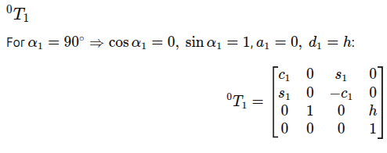
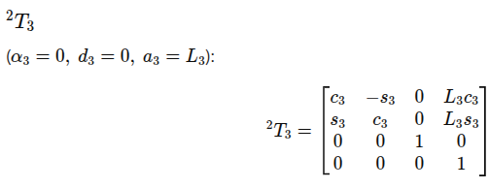
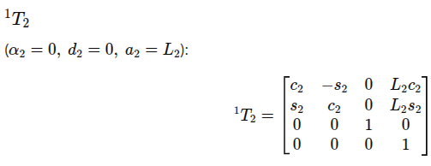
Exercise 2 (Cont.)

Slide 28

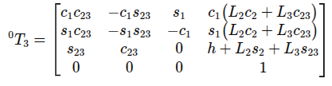
Exercise 2 (Cont.)
Did you familiar with the x, y and z value from the trigonometry method

Slide 29
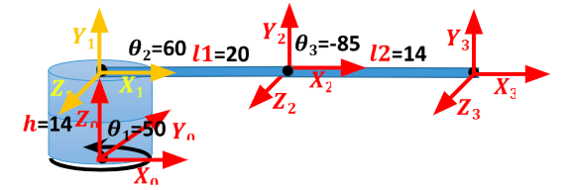
Home Work

Slide 30
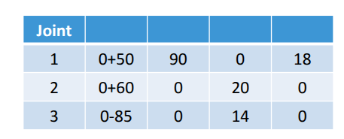
Home Work (Cont.)

Slide 31
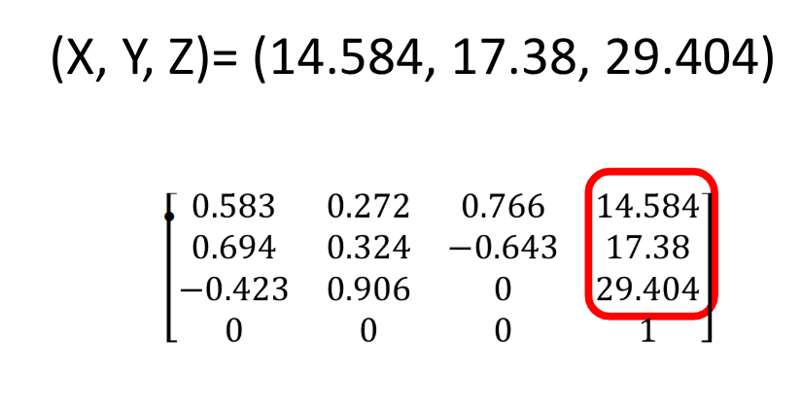
Home Work (Cont.)

